Slide 1
SysML v2 Submission Team (SST) SysML v2 Submission Overview & Status
Virtual OMG Meeting
ADTF
25 March 2020
Sanford Friedenthal
safriedenthal@gmail.com
Ed Seidewitz
ed-s@modeldriven.com
Manas Bajaj
manas.bajaj@intercax.com

Slide 2
SysML v2 Submission Team

Slide 3
SysML v2 Submission Team (SST)
SysML v2 Submission Team (SST) formed December 2017
Leads: Sandy Friedenthal, Ed Seidewitz
A broad team of end users, vendors, academics, and government liaisons
Currently over 140 members from 67 organizations
Developing submissions to both RFPs
Driven by RFP requirements and user needs

Slide 4
Track Leads
Project Management – Ed Seidewitz, Sandy Friedenthal
Infrastructure – John Watson
Requirements V&V – Sandy Friedenthal
Profile Development – Yves Bernard, Tim Weilkiens
Metamodel Development – Chas Galey, Bjorn Cole
API/Services Development – Manas Bajaj
Pilot Implementation – Ed Seidewitz

Slide 5
SST Participating Organizations
Academia/Research
End User
Tool Vendors
Government Rep
INCOSE rep *
Aerospace Corp
Airbus
ANSYS medini
Aras
Army Aviation & Missile Center
BAE
BigLever Software
Boeing
CCDC Armaments Center
CEA
Contact Software
Draper Lab
Elbit Systems of America
ESTACA
European Space Agency
Ford
Fraunhofer FOKUS
General Motors
George Mason University
GfSE
Georgia Tech/GTRI
IBM
Idaho National Laboratory
IncQuery Labs
Intercax
Itemis
Jet Propulsion Lab
John Deere
Kenntnis
LieberLieber
Lightstreet Consulting
Lockheed Martin
LSST
Maplesoft
Mgnite Inc
MITRE
ModelAlchemy Consulting
Model Driven Solutions
Model Foundry
NIST
No Magic/Dassault Systemes
OAR
Obeo
OOSE
Ostfold University College
Phoenix Integration
PTC
Qualtech Systems, Inc (QSI)
Raytheon
Rolls Royce
SAF Consulting *
SAIC
Siemens
Sierra Nevada Corporation
Simula Research Laboratory
Sodius Willert
System Strategy *
Tata Consultancy Services
Thales
Thematix
Tom Sawyer
UFRPE
University of Cantabria
University of Alabama in Huntsville
University of Detroit Mercy
University of Kaiserslautern / VPE
Vitech
88solutions

Slide 6
Key Elements of SysML v2
New Metamodel that is not constrained by UML
Grounded in formal semantics
Robust visualizations based on flexible view & viewpoint specification and execution
Graphical, Tabular, Textual
Standardized API to access the model

Slide 7
Next Public Incremental Release (2020-03 release)
Publicly available on Google Drive – April 10, 2020
Google group for comments and questions
https://groups.google.com/forum/#!forum/sysml-v2-release (to request membership, provide name, affiliation and interest)
Content
Read me file (includes installation instructions)
Specification documentation (Parts 1, 2, 3)
Training material for SysML textual notation
Installation file for Jupyter tooling
Installation site for Eclipse plug-in
Web access to Tom Sawyer tooling/repository

Slide 8
SysML v2 Language Architecture

Slide 9
SysML v2 Language Architecture
Kernel Modeling Language (KerML)
Root Syntax
Root syntactic elements without model-level semantics (e.g., packaging)
Direct semantic mapping to formal logic
semantic
specification
Core Syntax
Core Semantics
Declarative semantic base elements modeled using KerML
Kernel Syntax
metamodel
Kernel Model Library
semantic library
Declarative semantic base elements and domain-specific libraries modeled using SysML
Systems Modeling Language (SysML)
Systems Syntax
metamodel
Systems and Domain Model Libraries
semantic library

Slide 10
SysML v2 Language Update (2020-03 Baseline)

Slide 11
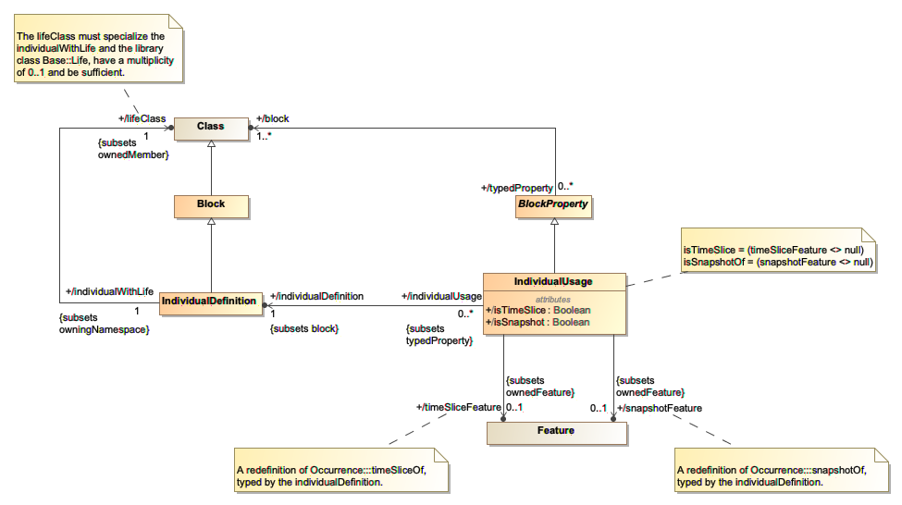
Individuals Abstract Syntax (Systems)

Slide 12
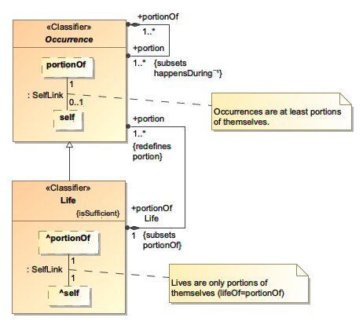
Individuals: Occurrences and Lives Model Library (Kernel)
A portion of an occurrence is a portion of its extension in time and/or space.
Occurrences are things with identity that exist in time and space (4D). Object and Part are specializations of Occurrence.
A “life” is the maximal portion of an occurrence in time and space (i.e., ”the entire thing over its entire lifetime”).

Slide 13
Individuals Textual Notation
individual def 'Temporal-Spatial Reference_ID1' :> 'Temporal-Spatial Reference';
individual def VehicleRoadContext_ID1 :> VehicleRoadContext;
individual def VehicleA_ID1 :> VehicleA;
individual def Road_ID1 :> Road;
individual reference : 'Temporal-Spatial Reference_ID1’ {
:>> referenceTime = DateTime(…);
snapshot context_t0 : VehicleRoadContext_ID1 {
:>> t = t0;
snapshot vehicle_ID1_t0 : VehicleA_ID1 {
:>> mass = m;
:>> position = p0;
:>> velocity = v0;
:>> acceleration = a0;
exhibit vehicleStates::on;
}
snapshot road_ID1_t0 : Road_ID1 {
:>> angle = theta0;
:>> surfaceFriction = sf0;
}
}
…
}

Slide 14
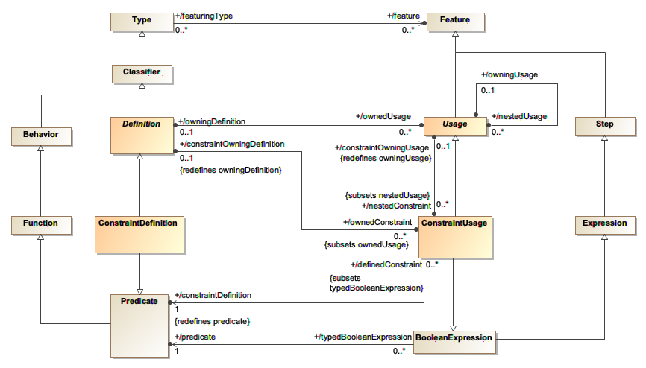
Constraints Abstract Syntax (Systems)

Slide 15
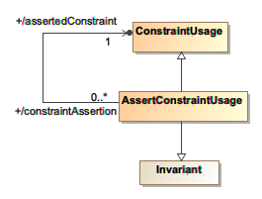
Constraints: Assertion Abstract Syntax (Systems)
An invariant is a Boolean expression that is asserted to be true.

Slide 16
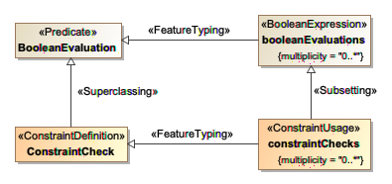
Constraints Model Library (Systems)
A constraint check is the evaluation of a constraint, which may be true or false.

Slide 17
Constraints Textual Notation
constraint def MassAnalysis3 (
totalMass : MassValue,
componentMasses: MassValue[0..*]);
constraint massAnalysis3 : MassAnalysis3 (
totalMass : MassValue,
componentMasses: MassValue[0..*]) {
totalMass == sum(componentMasses)
}
part vehicle1 : Vehicle {
assert massAnalysis3 (
totalMass = mass,
componentMasses = {engine::mass, frontAxleAssembly::mass, rearAxleAssembly::mass}
);
}
part vehicle2 : Vehicle {
assert constraint
{ mass == engine::mass + frontAxleAssembly::mass + rearAxleAssembly::mass }
}

Slide 18
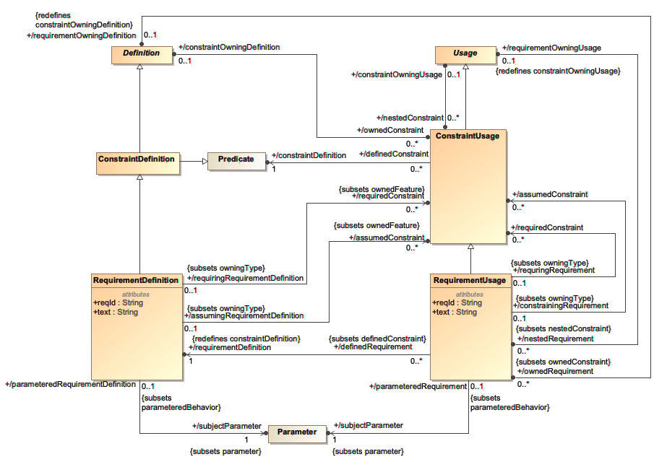
Requirements Abstract Syntax (Systems)

Slide 19
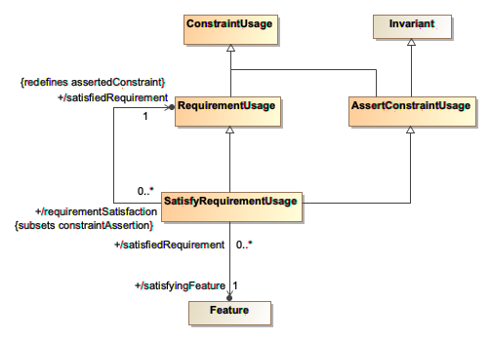
Requirements: Satisfaction Abstract Syntax (Systems)
The satisfying feature identifies the thing that fills the role of the subject of the requirement.

Slide 20
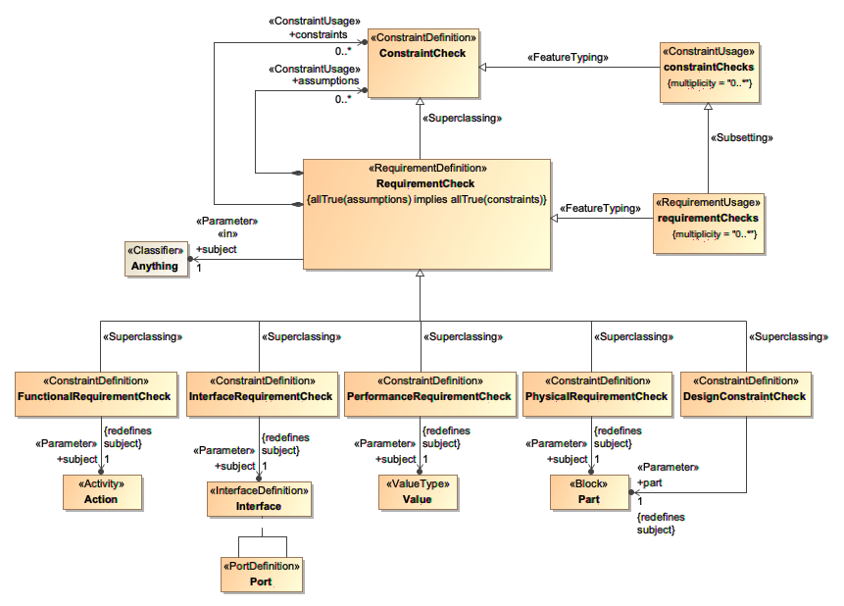
Requirements Model Library (Systems)
A requirement check is an evaluation of whether, for a given subject, if all the assumptions are true, then all the required constraints are true.
The requirement subclasses are tentatively based on the extended requirement stereotypes in Annex E.3 of the SysML v1 specification.

Slide 21
Requirements Textual Notation
requirement def "3" MassLimitationRequirement {
/* The actual mass shall be less than or equal to the required mass. */
value massActual: MassValue;
value massReqd: MassValue;
require constraint { massActual <= massReqd }
}
requirement "1.1" vehicleMass1: MassLimitationRequirement (vehicle: Vehicle) {
/* The vehicle mass shall be less than or equal to 2000 kg. */
value :>> massActual: MassValue = vehicle::mass;
value :>> massReqd = 2000@[kg];
assume constraint fuelConstraint {
/* full fuel tank */
}
}
part 'vehicle1_c1 Specification Context’ {
import 'Vehicle Usages'::vehicle_c1;
satisfy vehicleMass1 with vehicle1_c1;
}

Slide 22
SysML v2 API and Services

Slide 23
API Architecture – PIM and PSM
conforms to

Slide 24
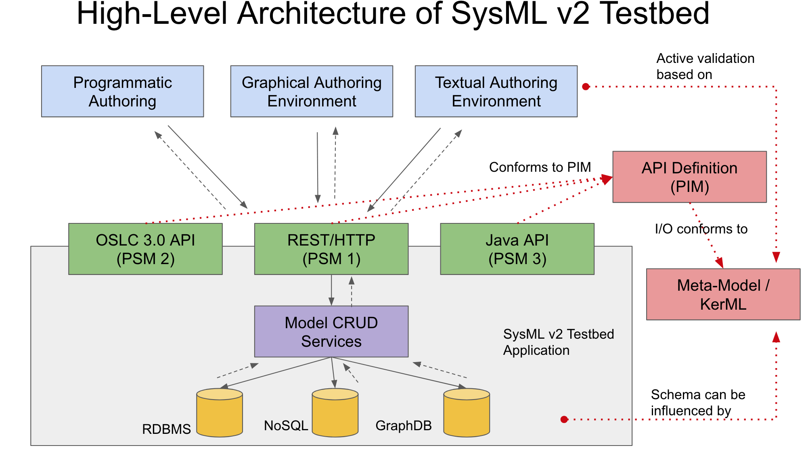
Pilot Implementation
Meta-Model based on KerML

Slide 25
SysML v2 API and Services RFP Scope
Mandatory Services
Model Navigation, Creation, Update, Deletion Services
External Relationship Management Service
Non-Mandatory Services
Model Query Service
Advanced Model Construction Services
Model View and Viewpoint Management Services
Model Analysis Services
Model Management Services
Versioning Service
Model Transformation Services
General Services – Timestamp and UUID generation, API Call Back
API Platform-Specific Models (API PSMs)
REST/HTTP binding
OSLC 3.0 binding
Done
In-progress

Slide 26
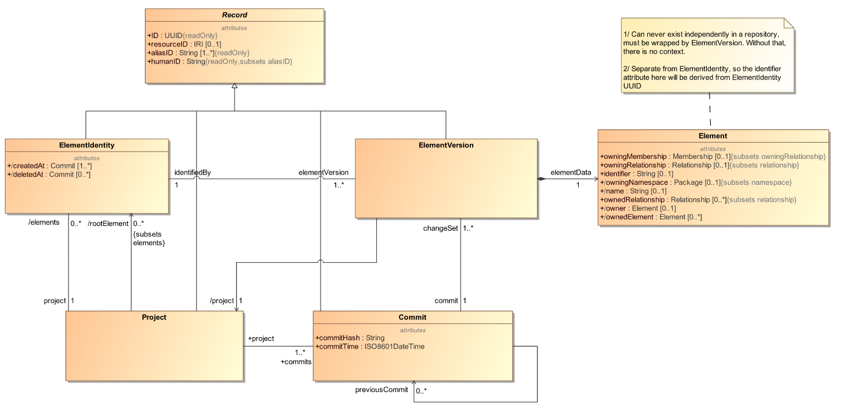
Lifecycle meta-model for element versioning service
Concepts being used for developing PIM and REST/HTTP implementation for element versioning service

Slide 27
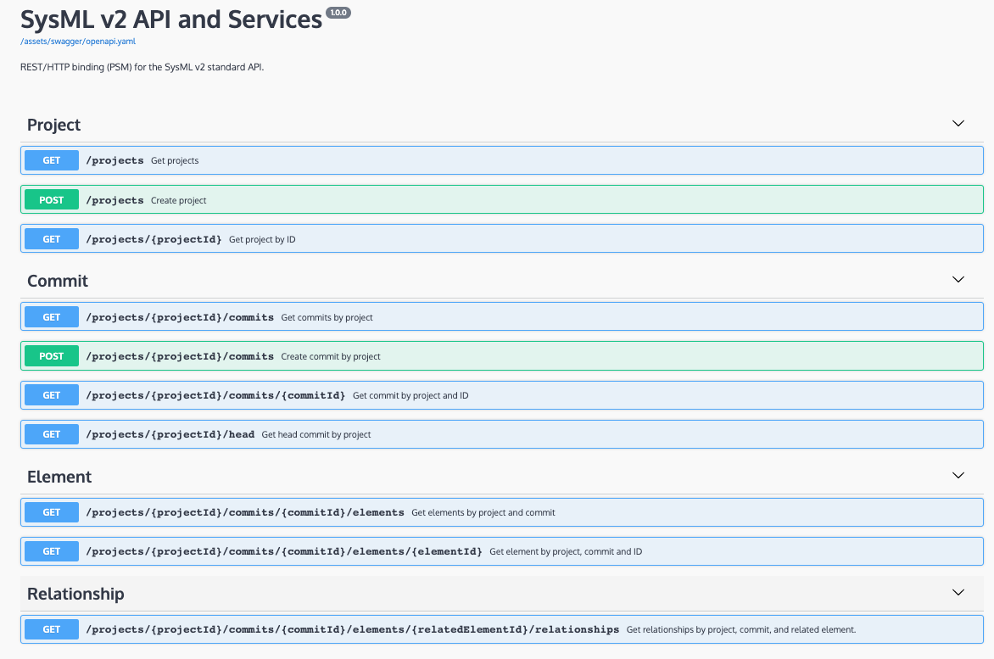
Versioning API (REST/HTTP) 2020-03 version
OpenAPI specification (OAI) for REST/HTTP binding of API

Slide 28
SysML v2 API Pilot Impl. Servers
sysml2 - For public release and use (generally outside SST)
Server URL: http://sysml2.intercax.com:9000
Swagger doc: http://sysml2.intercax.com:9000/docs/
Version deployed: 2019-12
sysml2-sst - For SST use - baseline for SST users such as those in Tracks 6/2
Server URL: http://sysml2-sst.intercax.com:9000
Swagger doc: http://sysml2-sst.intercax.com:9000/docs/
Version deployed: 2020-02
sysml2-dev - For SST Track 5 development
Server URL: http://sysml2-dev.intercax.com:9000
Swagger doc: http://sysml2-dev.intercax.com:9000/docs/
Version deployed: 2020-03-RC2

Slide 29
Initial Submission Roadmap

Slide 30
SST Initial Submission Roadmap (2020)
UPDATED MAR 2020
1st quarter (Jan – Mar)
Metamodel
Individuals and snapshots
Constraints (from Analysis)
Requirements
Properties, values and expressions
Profile
Initial concept
Parts tree validation case
API/Services
Versioning service
Initial graphical visualization concept
March OMG meeting presentation/demonstration
Incremental public release
2nd quarter (Apr – Jun)
Metamodel
Analysis & trades
Variant configuration
View and viewpoint (supporting graphical and textual notation)
Profile
UML4SysML to KerML transformation
API/Services
External relationship service (REST/HTTP and OSLC)
Query service
Traceability to RFP requirements
User Review #2
Initial draft of complete spec documents
June OMG meeting presentation/demonstration
Incremental public release

Slide 31
SST Initial Submission Roadmap (2020)
UPDATED MAR 2020
3rd quarter (Jul – Sep)
Metamodel
Verification
Language extension
Profile
All stereotypes defined
API/Services
View and viewpoint service
Precise semantics for time
Viewpoints for standard graphical diagrams
File-based model interchange
v1 to v2 migration transformation
Initial draft conformance tests
Initial submission (17 Aug)
September OMG meeting submission presentation/demonstration
Initial submission public release
Requesting new initial submission date

